Slide 1

Group Members
Ahmad Abdul Mogees i-16-0199
Khizar Shabbir I-16-0294
Supervisor: Dr. Omer Beg

Slide 2
Data Preparation
XML files with time tags
Txt files containing dialogues
JSON files containing persona
20 candidate sentences with one ground truth
Maintaining history of communication

Slide 3
Two Models
Seq 2 Seq LSTM
GPT using transfer learning

Slide 4
Limitations of Seq 2 Seq LSTM
Hot encoded vectors wave used
Not able to generate crosswords easily

Slide 5
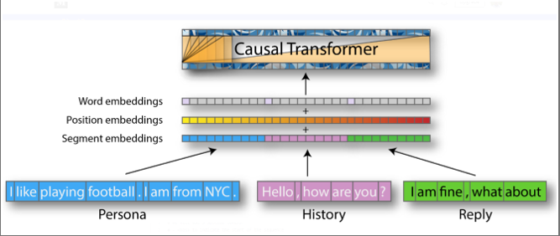
Gpt using transfer learning

Slide 6
Demo

Slide 7
Thank you

